Slide 1

Solving Mathematical Programming by GuRoBi with Python
Wang, I-Lin (王逸琳) 2021/7/24

Slide 2
Introduction
1

Slide 3


What is GUROBI?
A state-of-the-art solver for mathematical programming.

Slide 4

What is PYTHON?
An interpreted, interactive, and object-oriented programming language.
It is a high-level general-purpose programming language that can be applied to many different classes of problems
Source:
https://docs.python.org/3/faq/general.html#what-is-python

Slide 5
What problem that GUROBI can solve?
Linear Programming (LP)
Quadratic Programming (QP)
Quadratic Constrained Programming (QCP)
Mixed-Integer Linear Programming (MILP)
Mixed-Integer Quadratic Programming (MIQP)
Mixed-Integer Quadratic Constrained Programming (MIQCP)
Source:
http://www.gurobi.com/products/gurobi-optimizer

Slide 6
Why use GUROBI?
It supports interfaces for variety of programming and modeling languages:
Object-oriented interfaces for C++, Python, Java, and .NET
Matrix-oriented interfaces for C, MATLAB® and R
Links to standard modeling languages: AIMMS, AMPL, GAMS and MPL
Links to Excel through Premium Solver Platform and Risk Solver Platform
Faster and use less memory
Source:
http://www.gurobi.com/products/gurobi-optimizer

Slide 7
Why use PYTHON?
Easy to understand for beginner programmer
Have big developer community (Stack Overflow, Meetup, GitHub)
3rd most popular programming language out of 100 in September 2018 (According to the TIOBE index)
Source:
http://www.bestprogramminglanguagefor.me/why-learn-python
https://www.tiobe.com/tiobe-index/

Slide 8
Getting Started
2
How to install Gurobi & Python on your PC and know its basics

Slide 9


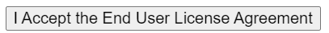
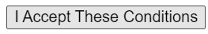
Install GUROBI for Universities
1. Click this link for more information www.gurobi.com/academia/for-universities
2. Register an “Academic” account,
3. Fill out your info, to install on several machines using xxx@gmail.com, you may use xxx+yy@gmail.com as your email, where yy is your machine name. e.g., xxx+aa@gmail.com for machine “aa” and xxx+bb@gmail.com for machine “bb”
4. After registration, login, go to https://www.gurobi.com/downloads/ click , then , choose one to download e.g., Gurobi-9.1.2-win64.msi , install it (and reboot),
5. Then install the academic license by https://www.gurobi.com/downloads/end-user-license-agreement-academic/ Click

Slide 10
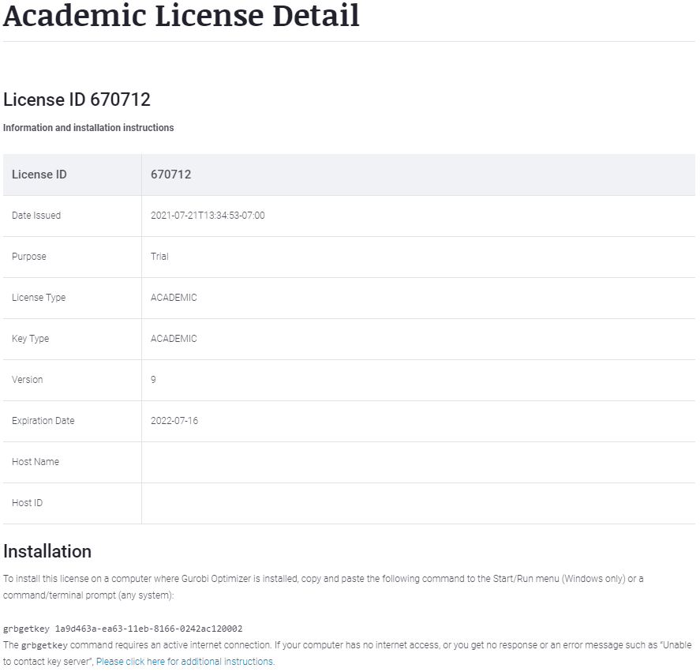
Install GUROBI (Academic version) New Academic License Acquired
!!Note!! Your IP MUST be an academic IP. You may need to use your school’s VPN, or go to school, connect to a wireless router that has an academic IP.

Slide 11

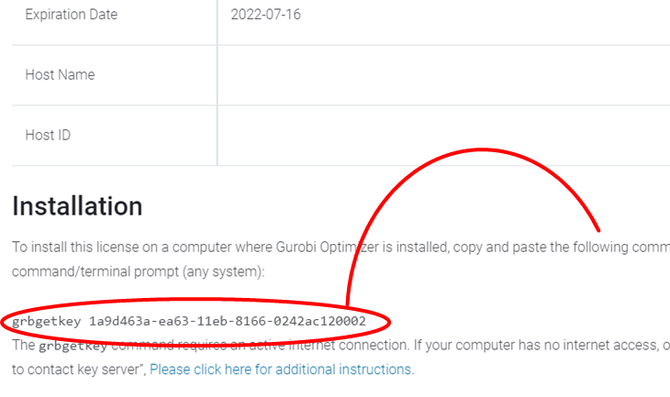
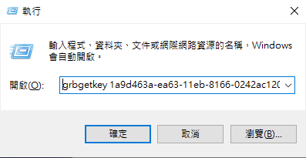
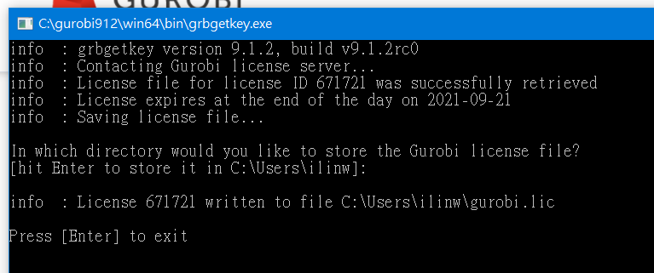
Install GUROBI license on Windows Use the New Academic License
Press + R, copy/paste the command “grbetkey…..”, click “Yes” Then, in the pop-out DOS-window, hit “Enter” to ensure installation

Slide 12
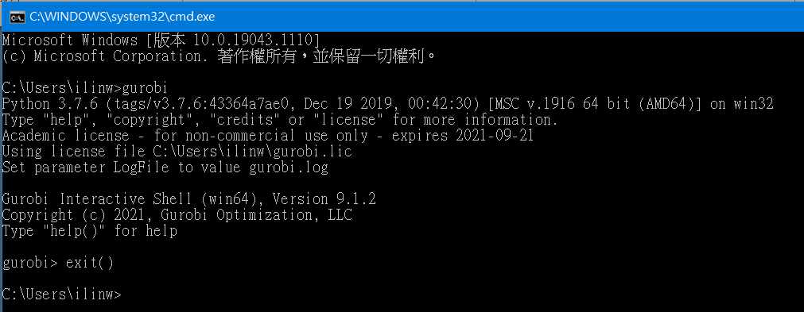
To ensure GUROBI Installation Open a DOS-Prompt window to test
Press + R, click “Yes” to open a DOS-Prompt window Then, in the pop-out DOS-window, keyin “gurobi” and “Enter”
If you see the message as below, it means the installation is done. You may keyin “exit()” to exit Guribi.

Slide 13
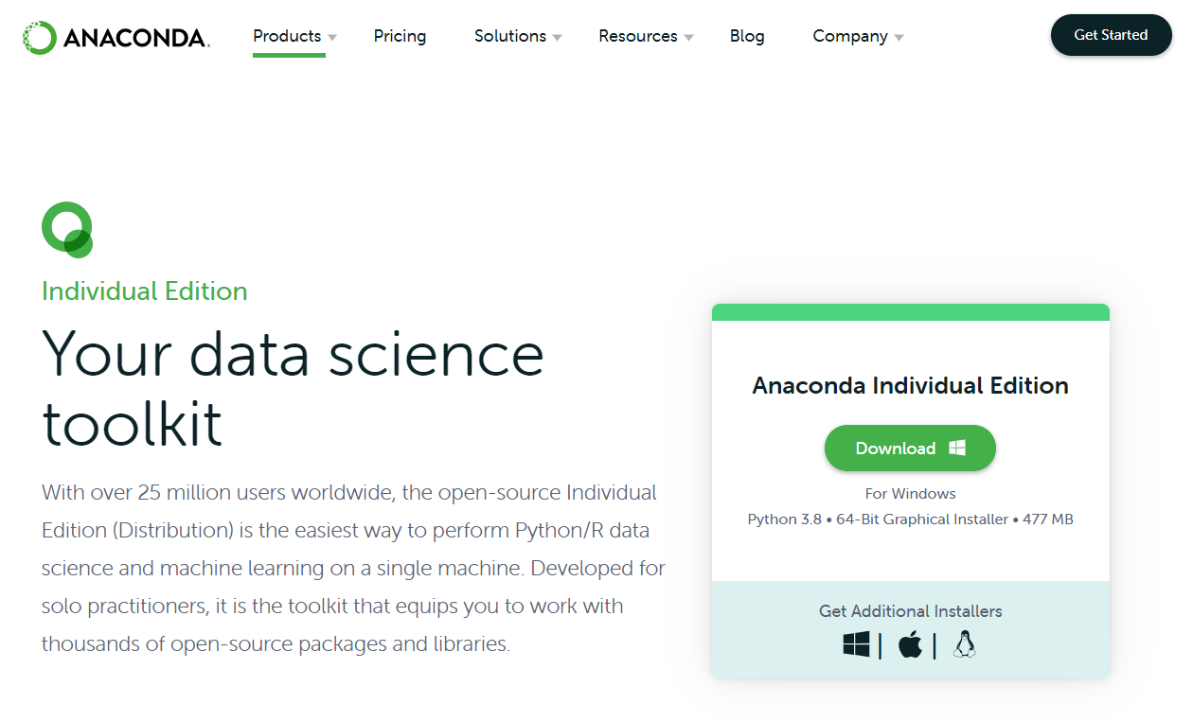
ANACONDA ANACONDA website
https://www.anaconda.com/download/

Slide 14
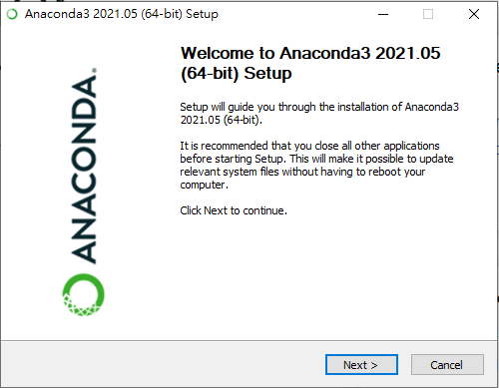
ANACONDA Install ANACONDA for Windows (1/4)
Launch the installer
Click Next

Slide 15
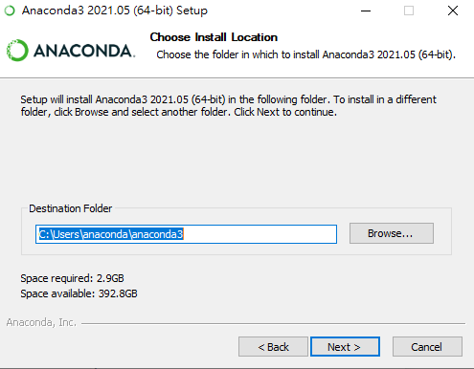
ANACONDA Install ANACONDA for Windows (2/4)
Read the licensing terms and click I Agree
Select an install for
“Just Me”
Select a destination folder to install Anaconda and click Next

Slide 16
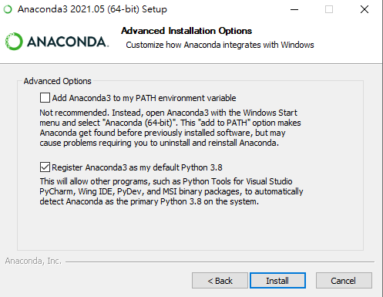
ANACONDA Install ANACONDA for Windows (3/4)
Choose whether to add Anaconda to your PATH environment variable.
We recommend NOT ADDING Anaconda3 to the PATH environment variable, since this can interfere with other software

Slide 17
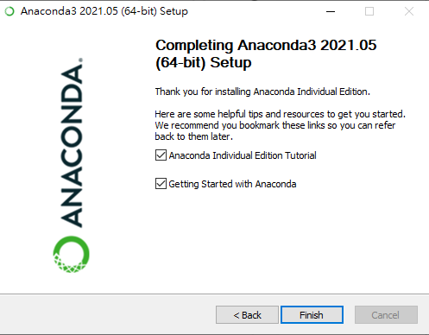
ANACONDA Install ANACONDA for Windows (4/4)
Click Install. You can click Show Details if you want to see all the packages Anaconda is installing.
Click Next.
After a successful installation you will see the “Thanks for installing Anaconda”

Slide 18
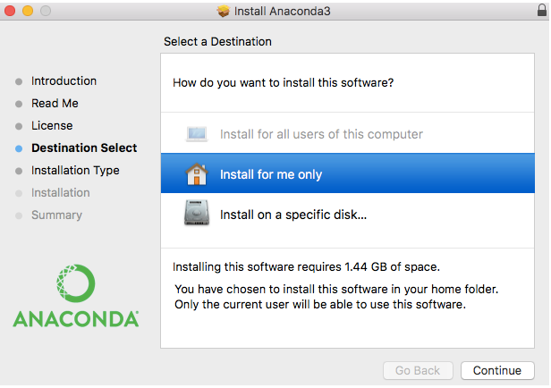
ANACONDA Install ANACONDA for Mac OS (1/2)
On the Destination Select screen, select Install for me only.

Slide 19
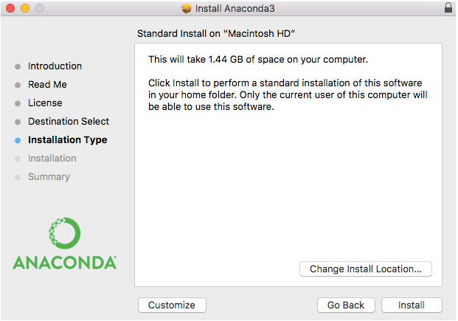
ANACONDA Install ANACONDA for Mac OS (2/2)
On the Installation Type screen, you may choose to install in another location. The standard install puts Anaconda in your home user directory
Click Install

Slide 20
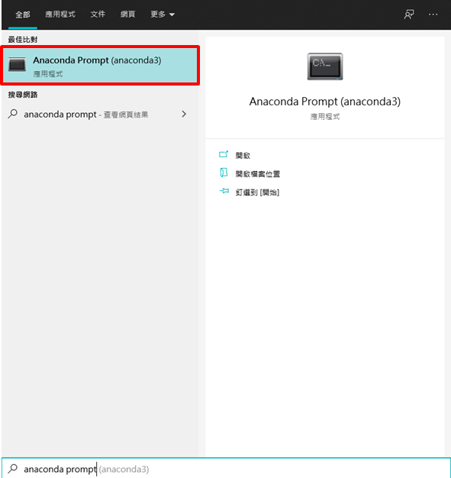
ANACONDA Access Anaconda Prompt
Click windows key (Winkey) and find “Anaconda Prompt” to pop out an MS-DOS window

Slide 21
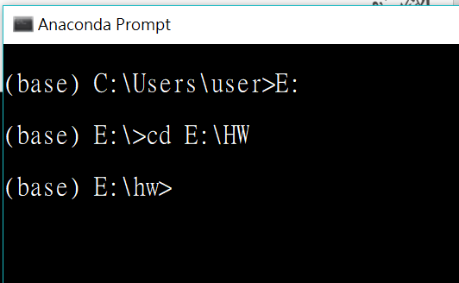
ANACONDA Set File Directory
Move to the .lp file directory you want to use
e.g., cd “E:\HW”

Slide 22
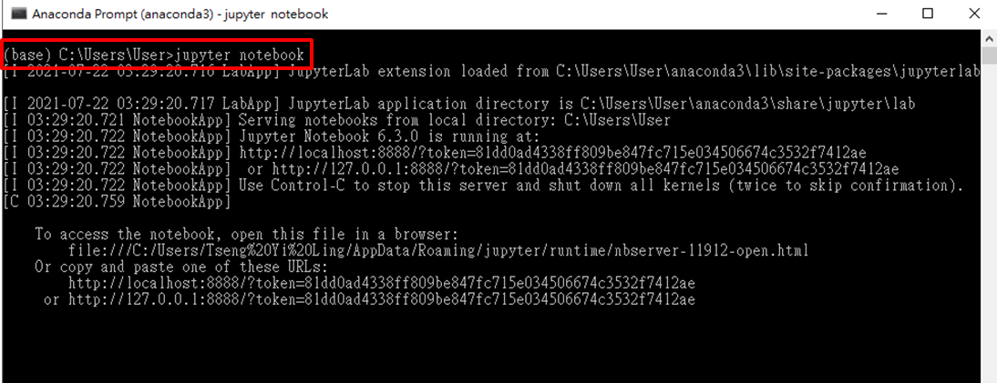
ANACONDA Open Jupyter Notebook
On Anaconda Prompt
Type >> jupyter notebook

Slide 23
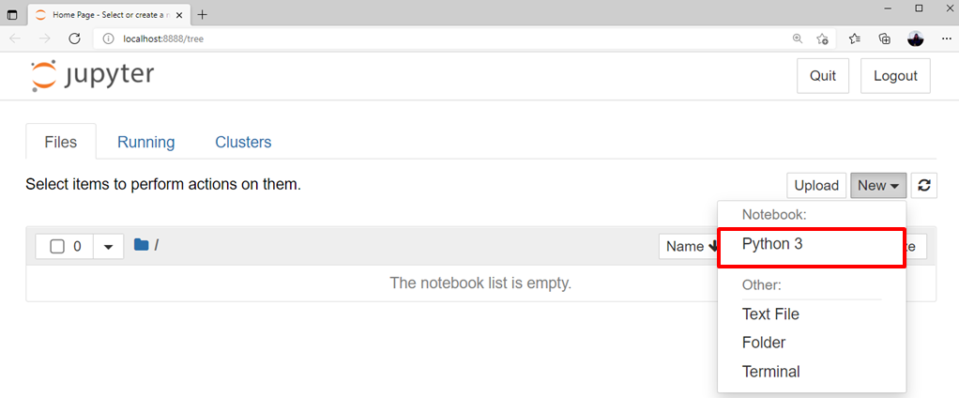
ANACONDA Create New File on Jupyter Notebook
If you succeed to open jupyter notebook, you will see the interface on your browser like this picture

Slide 24
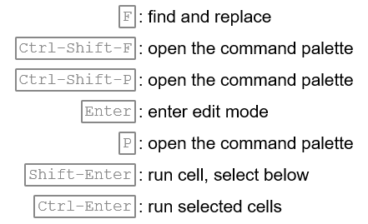
ANACONDA Jupyter Notebook Shortcut

Slide 25
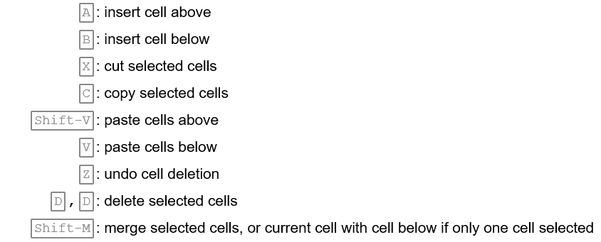
ANACONDA Jupyter Notebook Shortcut

Slide 26
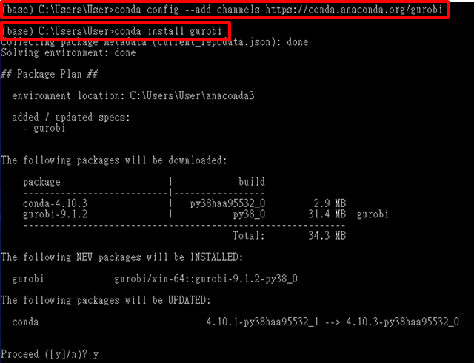
Install PYTHON For GUROBI Setting up ANACONDA and GUROBI
Open Anaconda Prompt again
Type >> conda config --add channels http://conda.anaconda.org/gurobi
Type >> conda install gurobi
Hit “y” to proceed

Slide 27
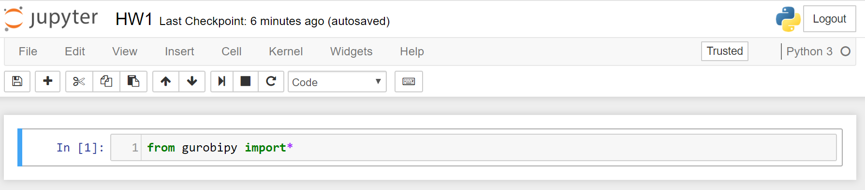
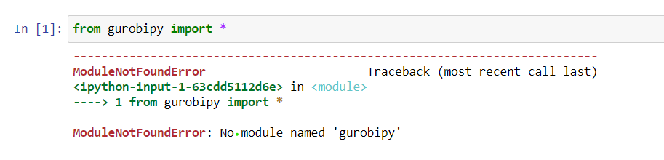
Install PYTHON For GUROBI Verify the Activation
Check whether both installation and activation are succeeded
Error message for failed installation

Slide 28
Interactive Mode of GUROBI
3
Solving the problem using Interactive mode

Slide 29

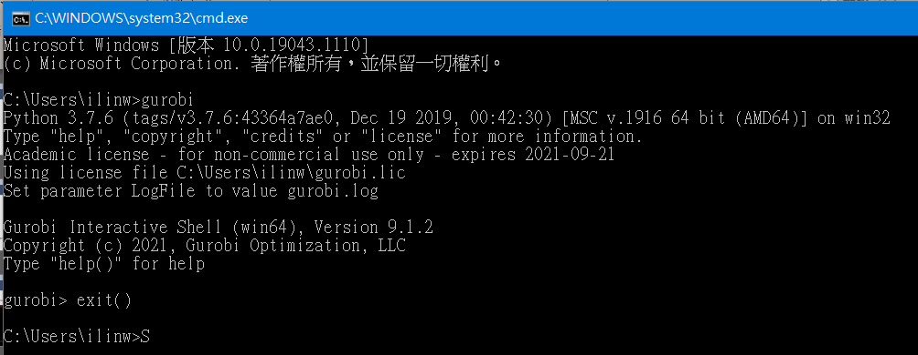
Access the interactive mode
There are three ways:
Click the Gurobi shortcut
Use Anaconda prompt
Open a DOS window (using cmd)

Slide 30
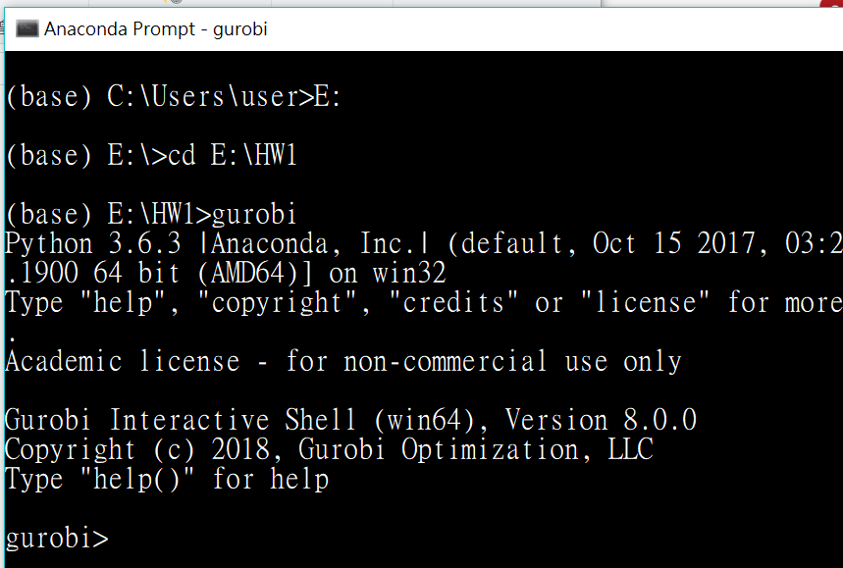
Access the interactive mode using anaconda prompt (1/3)
Open anaconda prompt
Go to the file test.lp directory
cd E:\HW1
Type “gurobi” or “gurobi.bat”

Slide 31
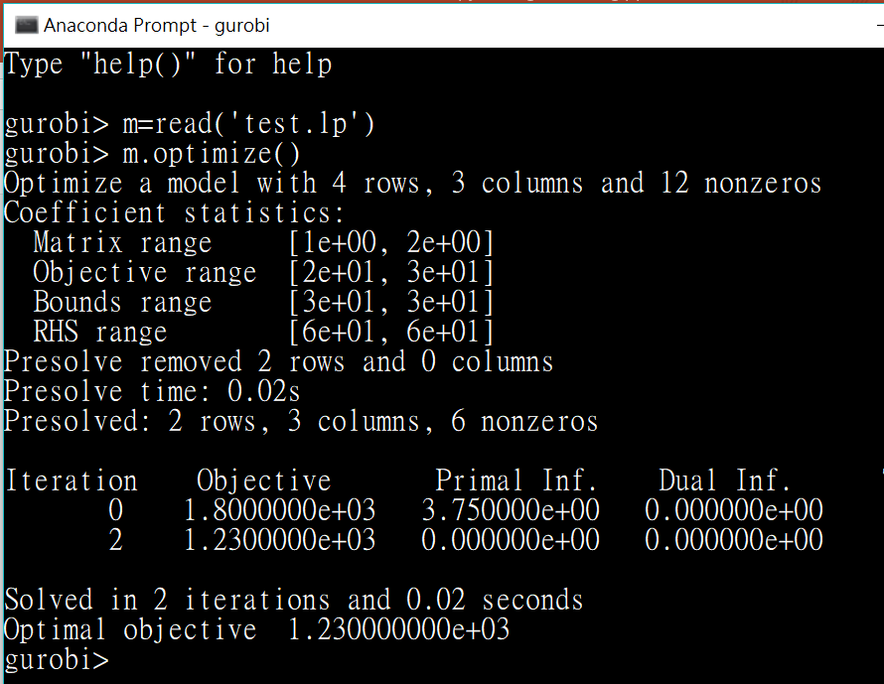
Access the interactive mode using anaconda prompt (2/3)
Read the file test.lp
m = read(‘test.lp’)
Optimize it
m.optimize()

Slide 32
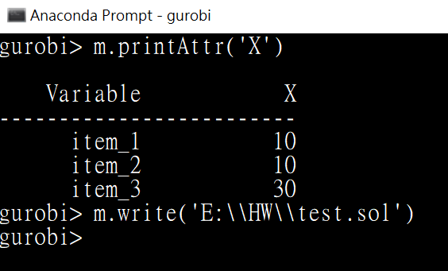
Access the interactive mode using anaconda prompt (3/3)
Print the optimal solution
m.printAttr(‘X’)
Output the optimal solution in file test.sol
by m.write(‘test.sol’)
or m.write(‘E:\\HW1\\test.sol’) or m.write(‘E:/HW1/test.sol’)
Remember to replace the original backslash “\” with double backslash “\\” or slash “/”

Slide 33
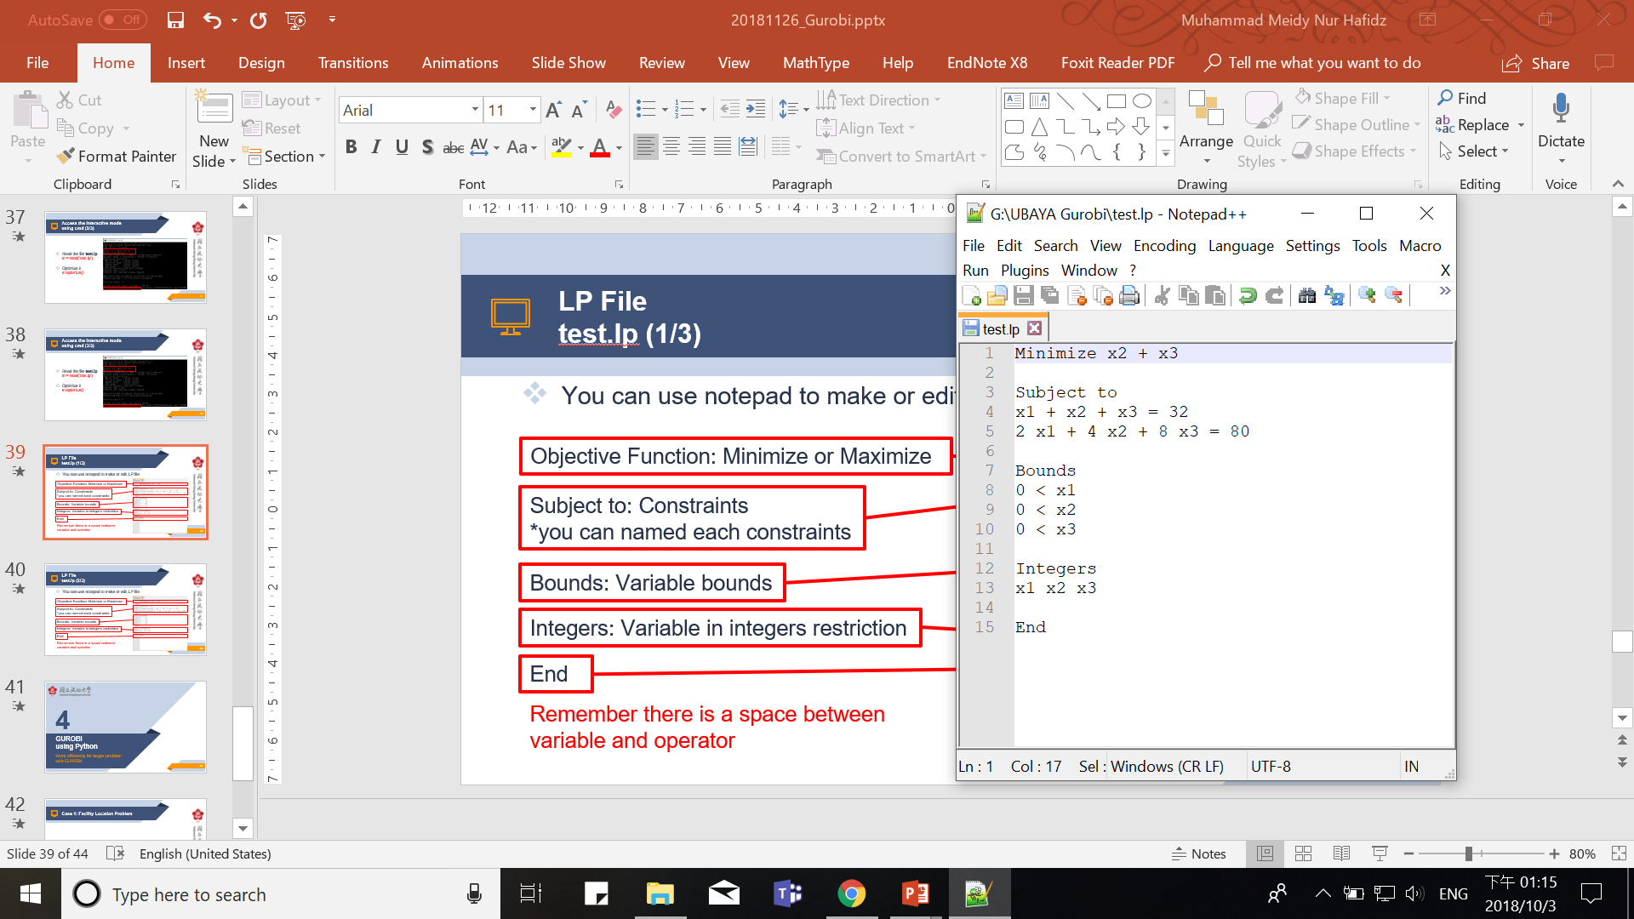
LP File test.lp (1/2)
You can use notepad++ to make or edit an LP file
Objective Function: Minimize or Maximize
Subject to: Constraints
Bounds: Variable bounds
Integers: Variable in integers restriction
End
Remember to leave a “space” between
variable and operator

Slide 34
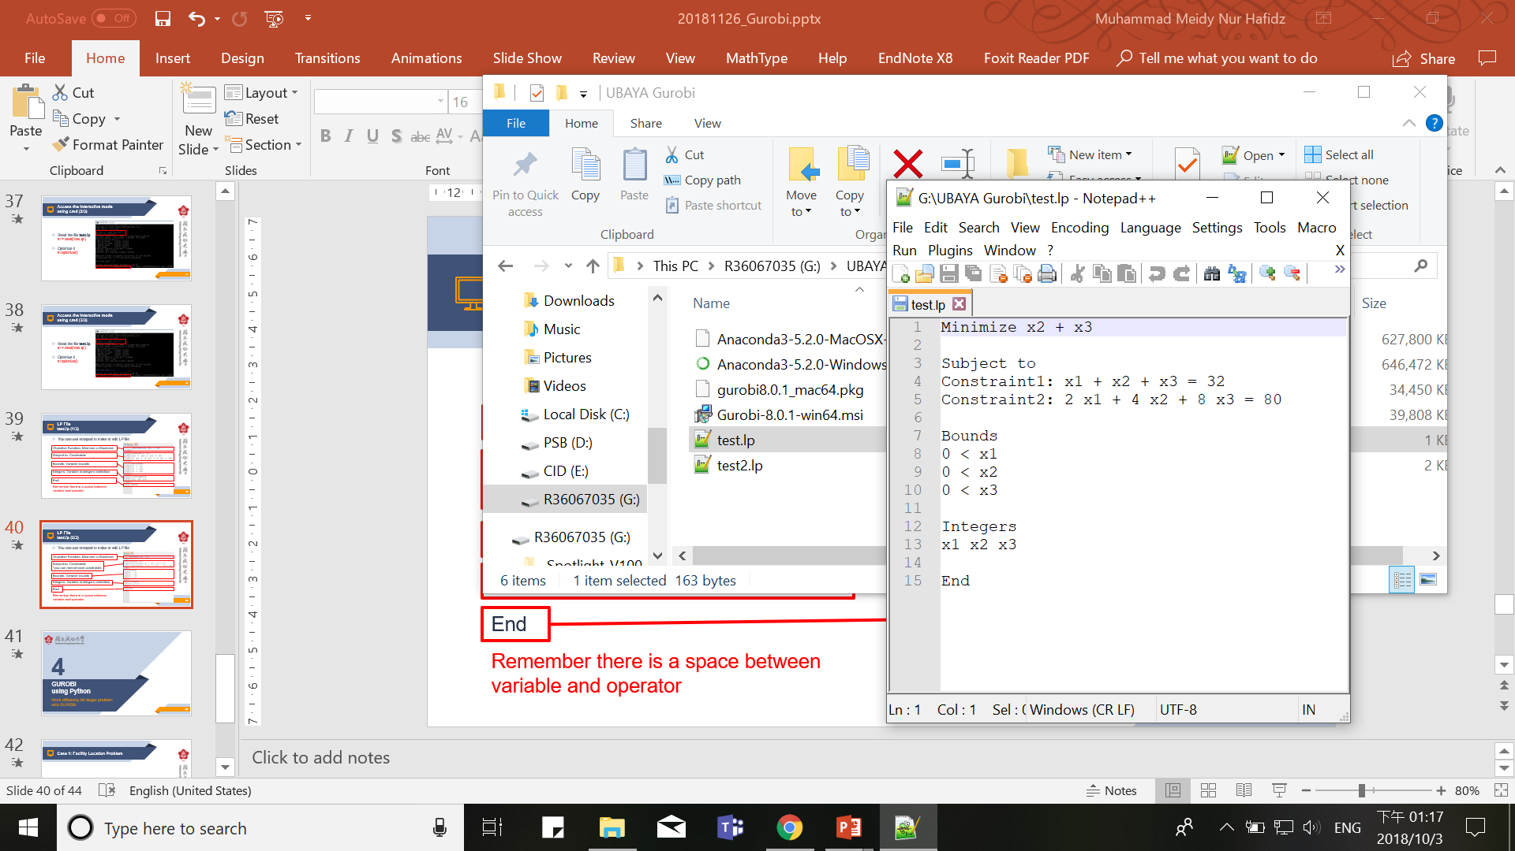
LP File test.lp (2/2)
The right hand side of the constraints are always constant
x1 + x2 < 32 – x3 ➔ ERROR!
you can name each constraint
Data types: binaries, integers
In Gurobi, the meaning of sense “<“ is equal to “≤”, similarly, “>” is equal to “≥”

Slide 35
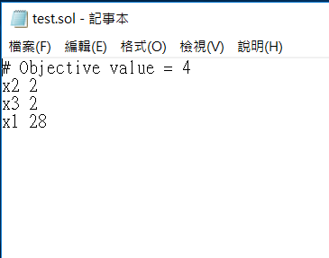
SOL File
You can use notepad++ to open SOL File

Slide 36
Introduction to Python for Gurobi
4
How to do python programming for Gurobi

Slide 37
PYTHON PROGRAMMING Linear Optimization Problem Example
Variables:
Maximize
Subject to

Slide 38
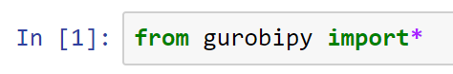
PYTHON PROGRAMMING Load the Gurobi Module
Module: a program written by another person
* means everything from a designated module
This allows using the various objects (variables, classes, methods, etc.) from the imported module without prefixing them with the module’s name.

Slide 39
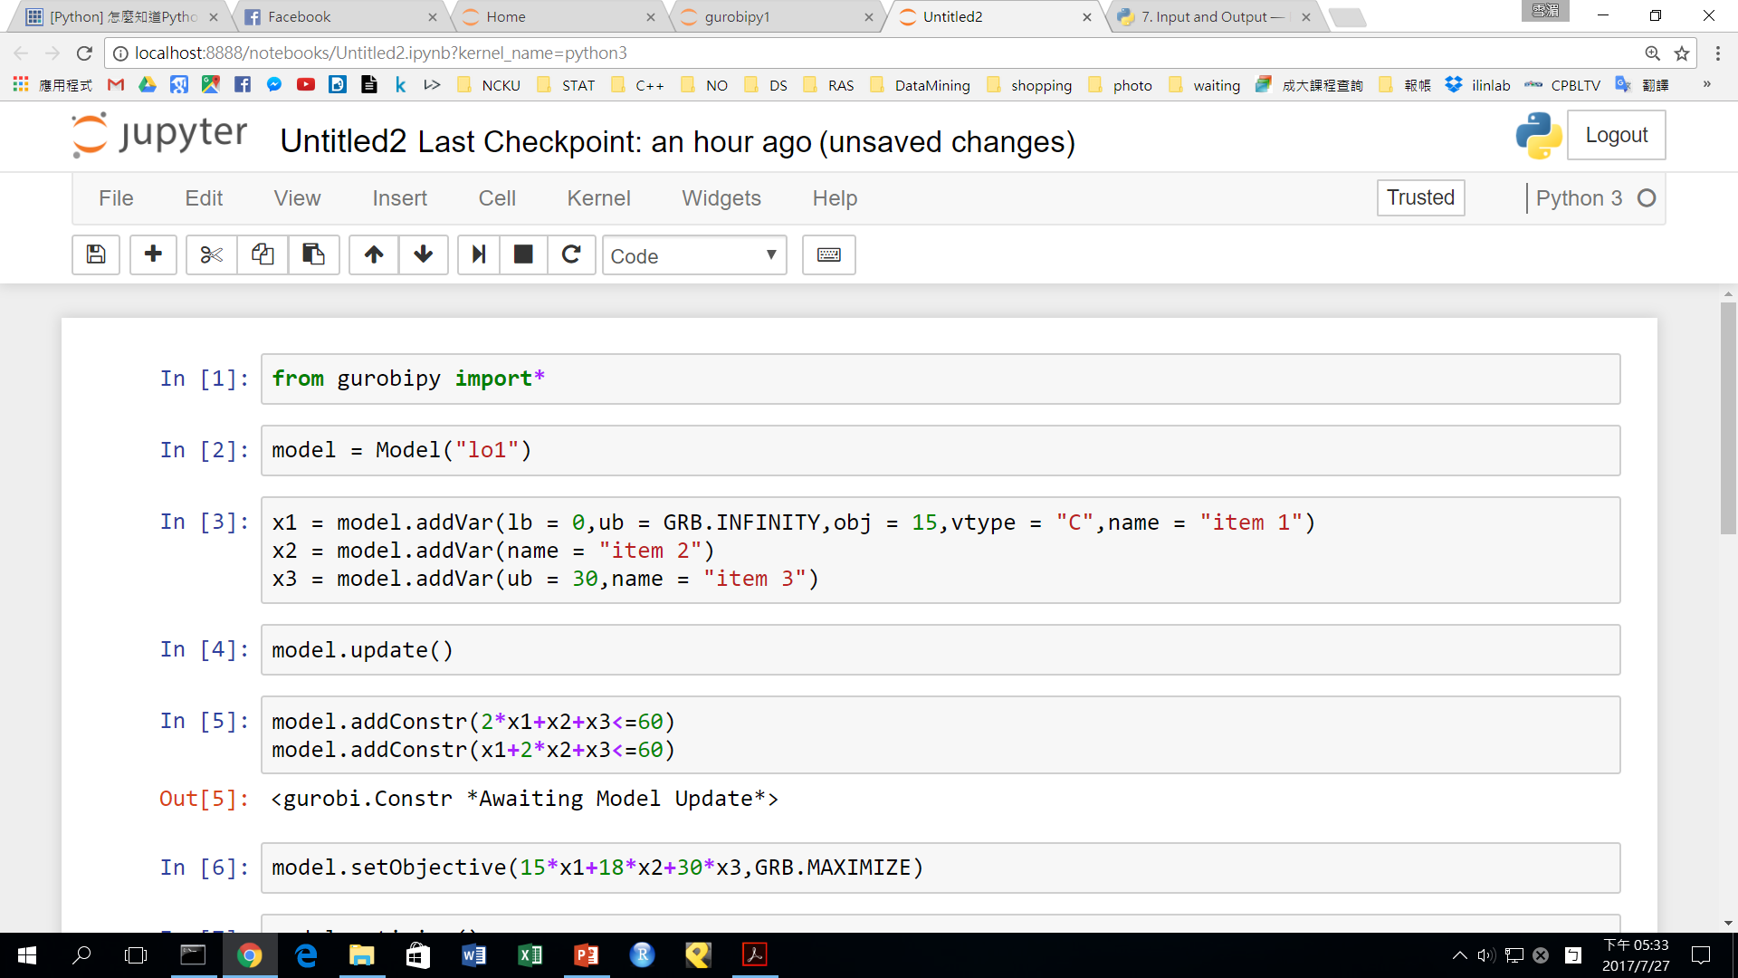
PYTHON PROGRAMMING Define the Model
Create an object “model” of the class “Model”
“lo1” is the name given to the model, it is okay to omit it.
Some method of class “Model”:
addVar(): add a variable
update(): inform Gurobi of model changes
addConstr(): add a constraint
setObjective(): specify objective function
optimize(): perform model optimization
ObjVal(): return the objective function value
getVar(): return a list containing variable objects

Slide 40
PYTHON PROGRAMMING Define Variables
Parameter of addVar():
lb: lower limit, default is 0
ub: upper limit, default is GRB.INFINITY
obj: objective function coefficient, default is 0
name: variable name
vtype: type of variable
C: continuous (default)
B: binary
I: integer
S: 0 or continuous within a certain range
N: 0 or integer within a certain range

Slide 41
PYTHON PROGRAMMING Model Update
Do it after adding variables, and before adding constraints

Slide 42
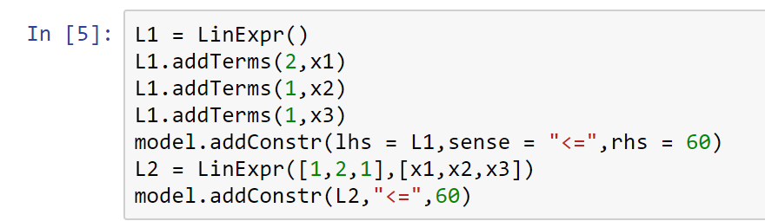
PYTHON PROGRAMMING Define Constraints (1/2)
Linear expression
Brief expression

Slide 43
PYTHON PROGRAMMING Define Constraints (2/2)
Parameter of addConstr():
lhs: information on the left side of the constraint
sense: the type of constraint direction (<, >, =)
rhs: information on the right side of the constraint
name: name of constraint

Slide 44
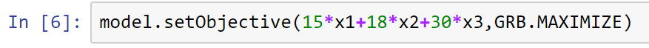
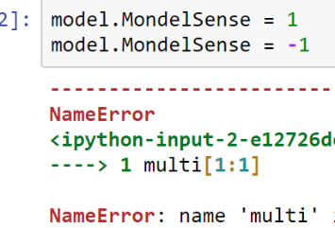
PYTHON PROGRAMMING Define Objective Function
Parameter of setObjective():
First argument: linear or quadratic expression
Second argument: GRB.MAXIMIZE or GRB.MINIMIZE
When the direction of the objective function is omitted…
: minimize (default)
: maximize

Slide 45
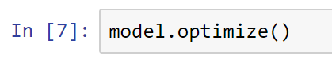
PYTHON PROGRAMMING Optimize Model (1/2)
It will automatically do the update method, so we do not need to execute update() here.

Slide 46
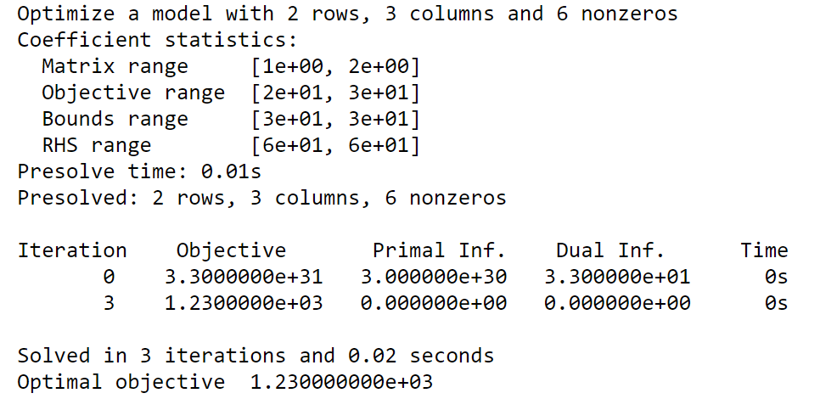
PYTHON PROGRAMMING Optimize Model (2/2)
The information of executing process will show below the kernel.

Slide 47
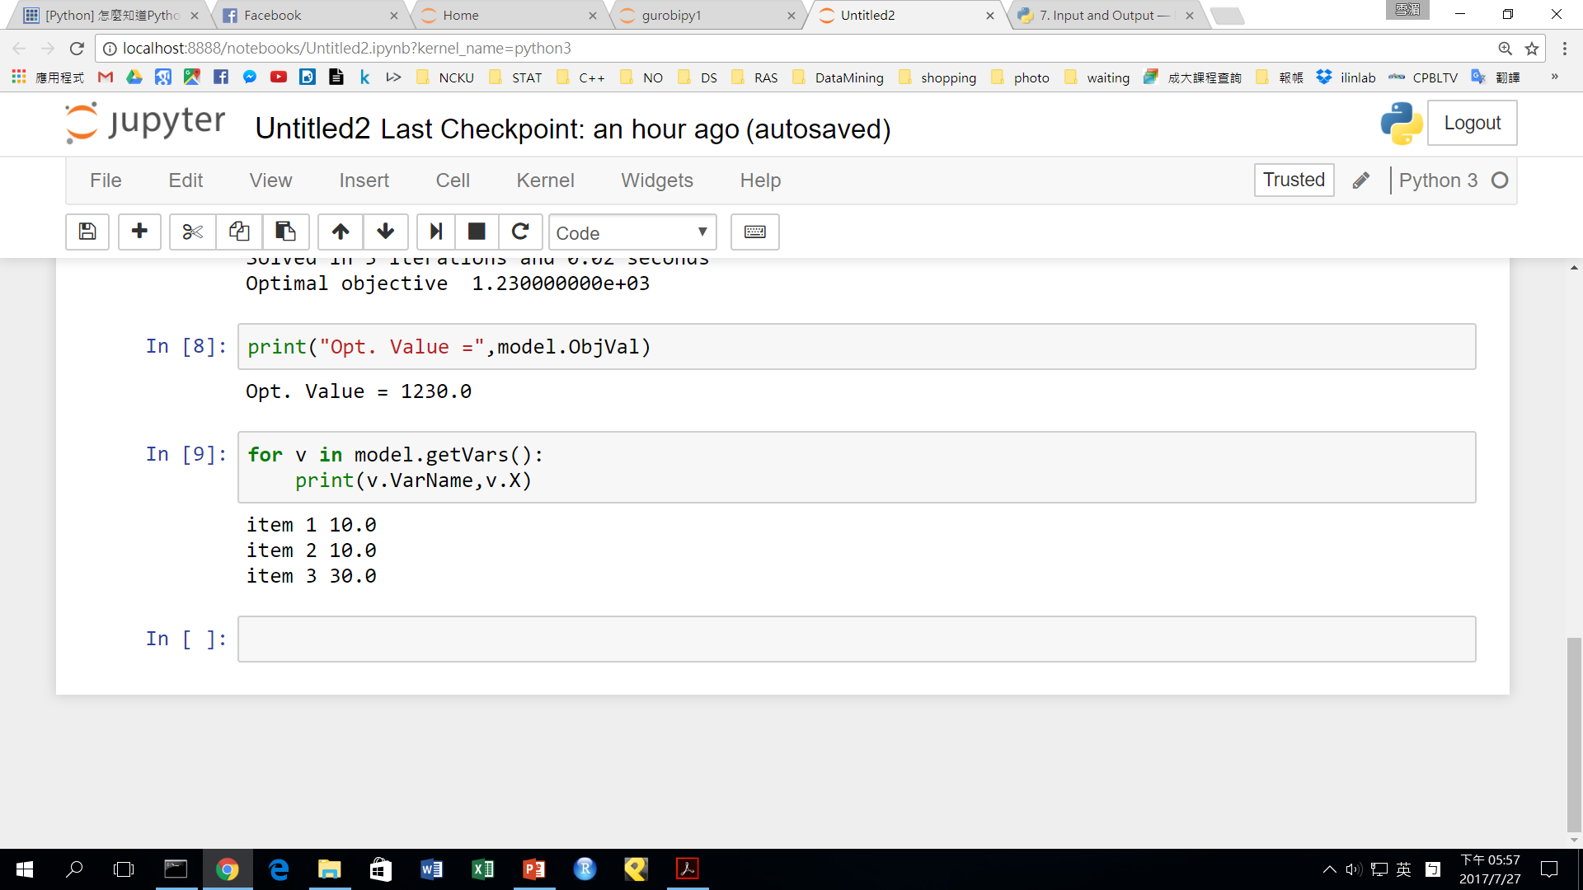
PYTHON PROGRAMMING Return Value (1/2)
Return objective function value
Use ObjVal to get the model objective function value, and use print() to output it.

Slide 48
PYTHON PROGRAMMING Return Value (2/2)
Return variables value
Use getVars to get the value of model variables, and use print() and for loop to output them.

Slide 49
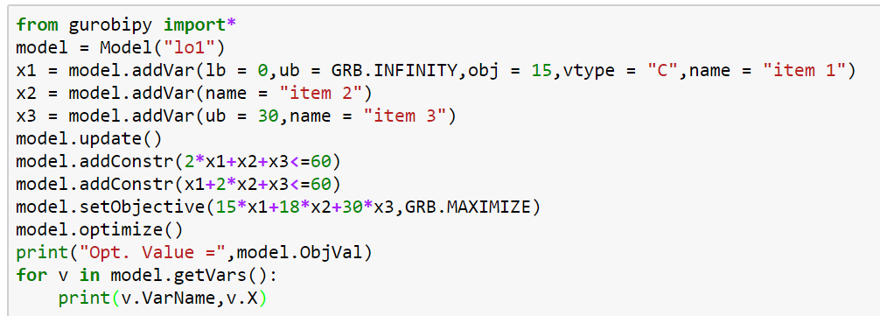
PYTHON PROGRAMMING Summary
The whole program is described as follows

Slide 50
More Examples
5
How does python for gurobi efficiently solve these examples?

Slide 51
Case 1: Transportation Problem Definition
Given
A list of m factories, each factory j has capacity
A list of n customers, each customer i has buy amount of product
= The cost of transporting a unit of product from factory j to customer i
= The amount of products transported from factory j to customer i
Question:
How to determine the amount of products to be transported from factory j to customer i so that the total cost is minimized without exceeding the factory capacity?

Slide 52
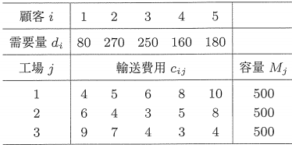
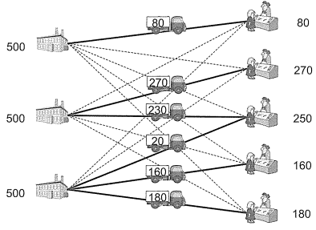
Case 1: Transportation Problem Problem Description
j=1
i=1
i=2
j=2
i=3
j=3
i=4
i=5

Slide 53
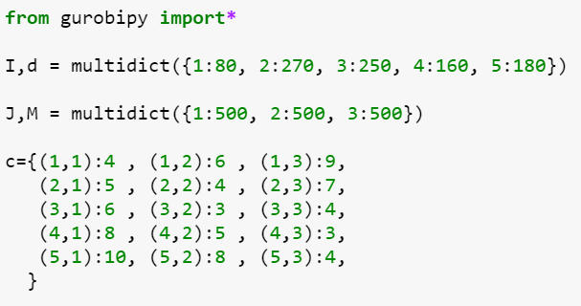
Case 1: Transportation Problem Solve the Problem (1/3)

Slide 54
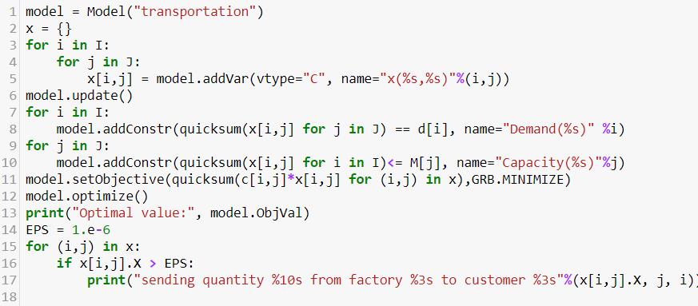
Case 1: Transportation Problem Solve the Problem (2/3)
The % operator, allows you to insert values into the string via format codes
(the %s in this case)

Slide 55
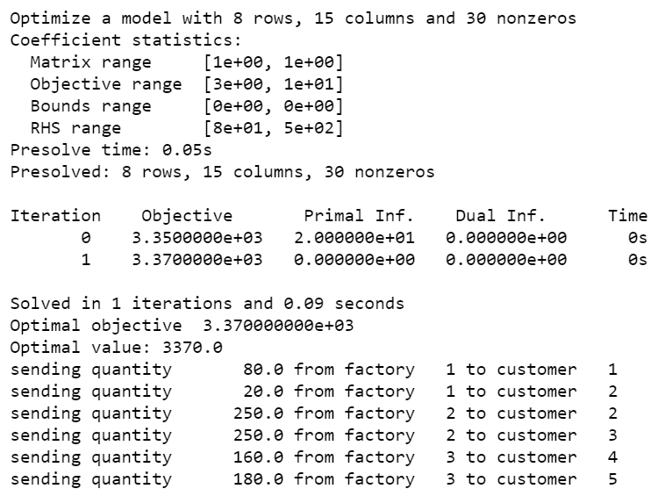
Case 1: Transportation Problem Solve the Problem (3/3)

Slide 56
Case 2: Knapsack Problem Definition
Given a set of items, each with a weight and a value,
determine which item to be included in a collection so that the total weight cannot exceed a given limit and the total value is as large as possible.

Slide 57
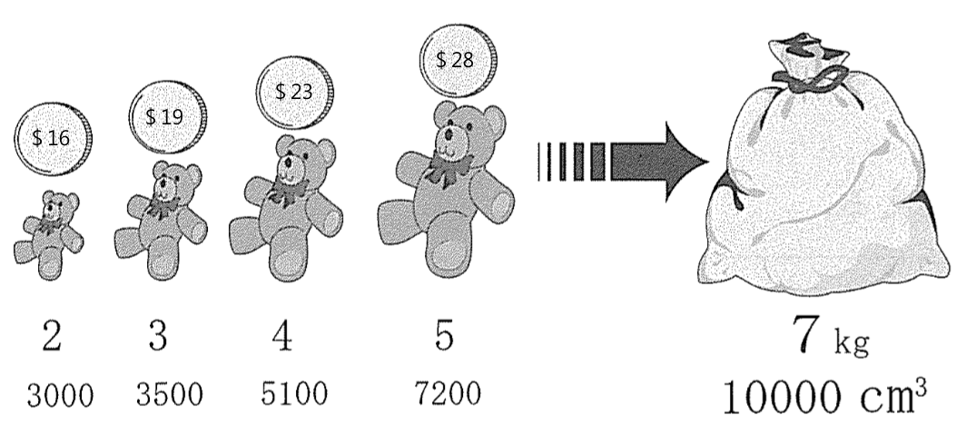
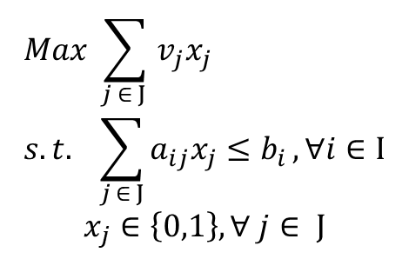
Case 2: Knapsack Problem Problem Description
i=1
i=2
j= 1 2 3 4

Slide 58
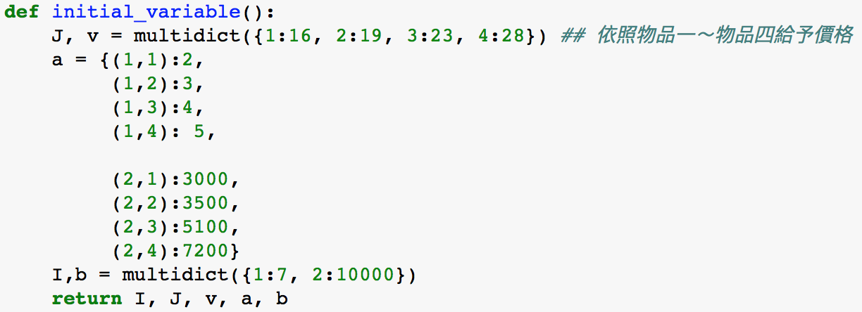
Case 2: Knapsack Problem Solve the Problem (1/5)
Define function: initialize the variable
Use function in Gurobi to do initialization
multidict
J: collection of items
v: item’s value
a: item’s info( weight, volume)
I: collection of constraints
b: constraint’s bound

Slide 59
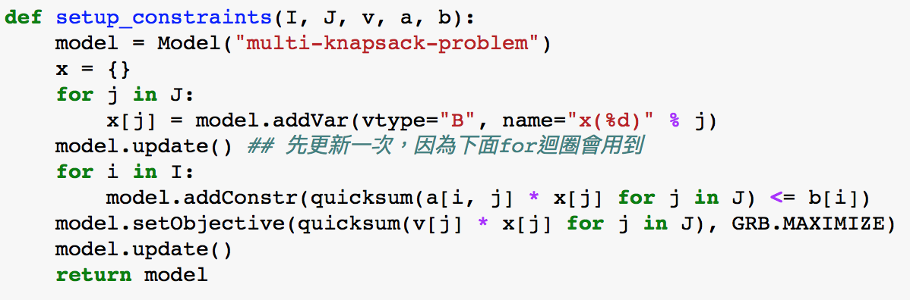
Case 2: Knapsack Problem Solve the Problem (2/5)
Define function: set up constraints

Slide 60
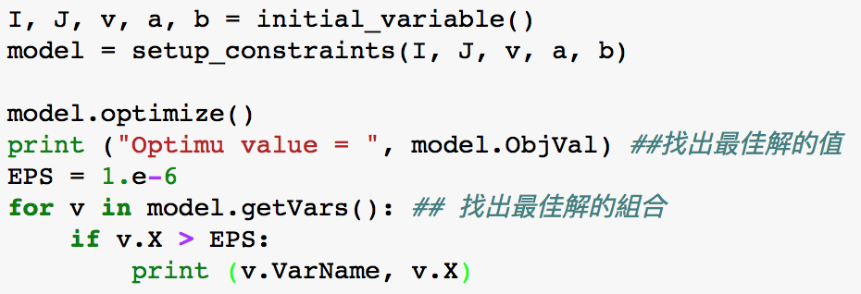
Case 2: Knapsack Problem Solve the Problem (3/5)
Start the function to solve the problem

Slide 61
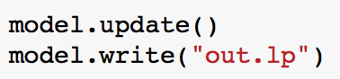

Case 2: Knapsack Problem Gurobi Output File Format (4/5)
Change output file format:
Linear programming format: [filename].lp
Mathematical Programming System format: [filename].mps

Slide 62

Case 2: Knapsack Problem Result (5/5)

Slide 63
Thank You
Q&A Session

